Slide 1

BEYOND BINARY
Radix Economy and
Native Ternary Hardware
Vanshika Agrawal · Vincent Cappone
New York University · Computer Engineering
NYU Tandon School of Engineering
Notes:
Welcome everyone. My name is Vanshika Agrawal and I'm presenting with Vincent Cappone. Our project is called 'Beyond Binary: Radix Economy and Native Ternary Hardware.' The core question we spent this project on is: can changing the number system that weights are stored in — from binary to balanced ternary — make AI hardware meaningfully cheaper and more energy-efficient? The short answer is yes, and we have silicon-level measurements to back it up.

Slide 2
Agenda
01
Introduction
The AI energy crisis and the case for hardware efficiency
02
Background
Binary vs. ternary arithmetic, balanced ternary encoding
03
Methodology
QAT training pipeline and ternary MAC hardware design
04
Evaluation
Track A & B results: accuracy, area, delay, and power
05
Conclusion
Findings, limitations, and future directions
Notes:
Quick roadmap of the next 20 minutes. We'll start with WHY this matters — AI's growing energy cost. Then background on what ternary arithmetic actually is. Then the methodology — how we trained ternary neural networks and how we designed the hardware. The bulk of the presentation is evaluation — real accuracy numbers, real synthesis numbers, real power measurements. And we'll close with what this all means. Feel free to ask questions as we go.To summarize in four sentences: Ternary quantization via QAT consistently matches or exceeds float accuracy — the regularization effect is robust and reproducible. On Nangate45 silicon, Track A ternary hardware is 46.5% smaller, 4.1% faster, and uses 81.9% less energy per inference. Track B shows the sweet spot at 3-trit weights — 26% cheaper hardware than INT8 with richer weight precision than 1-trit. And the fundamental architectural lesson is that radix economy is substrate-dependent: on binary CMOS, the benefit is captured by ternary weight encoding up to 3 trits, but native ternary devices would extend this advantage much further. Thank you.

Slide 3
Introduction: The AI Energy Crisis
~3×
8-bit×8-bit
~30%
AI energy demand by 2030
(vs today)
Integer MAC: industry standard
for DNN inference
of datacenter power from
compute alone
The Bottleneck
Our Hypothesis
Modern deep neural networks require billions of multiply-accumulate (MAC) operations per inference. On standard 8-bit binary hardware, each MAC requires a full 8×8 bit multiplier — expensive in area and power.
Ternary-quantized weights {-1, 0, +1} replace expensive multipliers with mux-based operations. Extending to multi-trit precision could achieve better accuracy while keeping hardware cheaper than INT8.
Notes:
Let's start with the problem we're trying to solve. AI inference is expensive. Modern data centers spend roughly 30% of their power budget just on compute, and that number is projected to triple by 2030. The bottleneck is the multiply-accumulate operation — the MAC — which is executed billions of times per image in a deep network. The industry standard today is INT8: 8-bit signed integer weights multiplied by 8-bit activations. That requires a full 8×8 bit multiplier. Our hypothesis is that if we use ternary weights — just three values, minus one, zero, and plus one — we can replace that expensive multiplier entirely. This slide sets up the motivation. The question is whether the hardware savings are real and whether the accuracy holds up.

Slide 4
Background: Binary vs. Balanced Ternary
Binary (Standard)
Balanced Ternary
Digits: {0, 1} — 2 values per digit
16-bit weight: 65,536 distinct values
8×8 multiplier: 16 partial product rows
Sign-extension overhead for negatives
Two's complement: sign bit complicates
partial product summation
Digits: {-1, 0, +1} — 3 values per digit
11-trit weight: 177,147 distinct values
11×11 multiplier: only 11 partial rows
Negation is FREE — just swap wires
No sign extension needed — every
trit carries its own sign
VS
Notes:
Before we get to results, let me explain what balanced ternary actually is, because it's not something most people encounter. In binary, each digit is 0 or 1. In balanced ternary, each digit — called a trit — is minus 1, zero, or plus 1. So a weight that in binary might be stored as 8 bits with 256 possible values, in balanced ternary can be stored as a few trits. The key advantage on the right side: negation is FREE. To negate a number in balanced ternary, you just swap the plus-one and minus-one wires. That's a wire crossing — no logic gates, no transistors, no adder chain. This is fundamentally different from two's complement binary where negating requires inverting all bits and adding one. And because each trit carries its own sign, you never need sign extension in the adder tree. These two structural advantages are what drive the hardware savings we'll show you.

Slide 5
Background: Ternary Encoding & MAC Operation
One-Hot Per-Sign Encoding
MAC Datapath
{neg=0, pos=0}
→
0 (zero)
Weight trits w[N:0]
{neg=0, pos=1}
→
+1 (positive)
{neg=1, pos=0}
→
−1 (negative)
MUX banks → {+x, 0, −x}
{neg=1, pos=1}
→
FORBIDDEN
N Partial products
The Key Hardware Insight
Scale by 3^j (shift-add)
Negation = wire swap
Swapping neg↔pos bits negates a trit — zero gates, zero transistors. Partial products = 3:1 mux
Each weight trit selects {+x, 0, −x} for the activation — no AND-gate array.
Binary adder tree sum
24-bit Accumulator
Notes:
This slide shows how we actually encode trits in hardware, and what the MAC datapath looks like. We use a two-bit one-hot encoding per trit: bit pattern 01 means plus-one, 10 means minus-one, 00 means zero. The pattern 11 is forbidden. The key insight is in the bottom-left box: when a weight trit is minus-one, the partial product is the negated activation. In hardware, that negation is literally just swapping the two wires of each encoding pair. Zero transistors. Zero gates. Free of resources. On the right, the MAC datapath: each weight trit selects from plus-x, zero, or minus-x using a 3-to-1 mux. These N partial products get scaled by powers of 3 — using cheap shift-and-add operations — and summed in a small binary adder. The result accumulates into a 24-bit register. This is the architecture we implemented in Verilog and synthesized.

Slide 6
Methodology: Quantization-Aware Training (QAT)
Pre-train
ResNet-18
QAT
Fine-tune
Snap
Weights
BatchNorm
Recalib.
Evaluate
Accuracy
FP32 weights
CIFAR-10/100
15 epochs, SGD
Simulate ternary
weights in forward
STE backward pass
Convert masters
to true {−1, 0, +1}
per threshold α
Re-run 1k images
in train() mode
update statistics
CIFAR-10/100
test set
compare vs FP32
Straight-Through Estimator (STE) — the key trick
Ternary snapping is non-differentiable (gradient = 0 everywhere). STE bypasses this: during the forward pass, weights are snapped to {−1, 0, +1}. During backprop, gradients flow straight through as if no quantization occurred. This lets the optimizer adjust real float weights toward values that survive snapping — the network learns to live within ternary constraints.
CIFAR-10 Result
CIFAR-100 Result
FP32 baseline: 85.31% Ternary QAT (α=0.10): 86.66% (+1.35%) ✓
FP32 baseline: 61.18% Ternary QAT (α=0.10): 62.02% (+0.84%) ✓
Notes:
Now the software side. How do you train a neural network that works with ternary weights? The naive approach — post-training quantization — just snaps weights to minus-one, zero, plus-one after training. We tried this. It collapses accuracy to around 40% on CIFAR-10. The network was never prepared for such brutal rounding. Quantization-Aware Training is the fix. During fine-tuning, every forward pass uses fake ternary weights via the Straight-Through Estimator. The network sees what inference will look like and learns to cluster its weights near minus-one, zero, and plus-one naturally. Gradients still flow through the real float weights, so the optimizer can still improve the model. The critical additional step is BatchNorm recalibration: after ternarizing, we run about a thousand images through the model in training mode so BatchNorm can relearn what 'normal' activation magnitudes look like under ternary weights. Without this, accuracy collapses to random guessing. The results are in the bottom two boxes. On CIFAR-10 we went from 85.31% baseline to 86.66% with ternary QAT — that's better than the float model. On CIFAR-100 similarly, 61.18% to 62.02%. We'll dig into this more in the evaluation section.

Slide 7
Methodology: Hardware Design & Synthesis Flow
RTL Design
Functional
Verification
Synthesis
(Yosys)
Timing & Power
(OpenSTA)
Verilog: ternary MAC,
bt_full_adder, bt_pp_gen,
standard_mac (baseline)
Icarus Verilog sim
300-800 test vectors
Python golden ref
abc -g cmos2
Gate-level netlist
Cell & transistor count
Nangate45 Liberty
Critical path delay
Power analysis
Three Designs Compared
Track A: 1-trit × 8-bit
Track B: N-trit × 8-bit
Baseline: 8-bit × 8-bit
Single balanced ternary weight digit,
full 8-bit binary activation
Multi-trit weight (N=3,4,5),
full 8-bit binary activation
Standard binary INT8 MAC,
Yosys Booth-encoded multiplier
Notes:
On the hardware side, the pipeline has four stages. First, we wrote the RTL in Verilog. The key modules are the ternary MAC with its mux-based partial product generator, the balanced ternary full adder, and the standard binary MAC as a baseline. Second, functional verification using Icarus Verilog. We generated hundreds to thousands of test vectors from a Python golden reference model and verified bit-exact match for every case. This is important — you'll see the '25 passed 0 failed' output on the next slide. Third, synthesis with Yosys using the abc -g cmos2 flag, which maps to a technology-independent CMOS gate library. This gives us normalized cell counts and gate equivalents that are valid across any reasonable process node. Fourth, for Track A we went all the way to OpenSTA on Nangate45 — a real 45nm standard cell library — which gives us actual area in square micrometers, delay in nanoseconds, and power in microwatts. We built three designs: Track A with single-trit weights, Track B with N-trit weights, and the binary baseline.

Slide 8
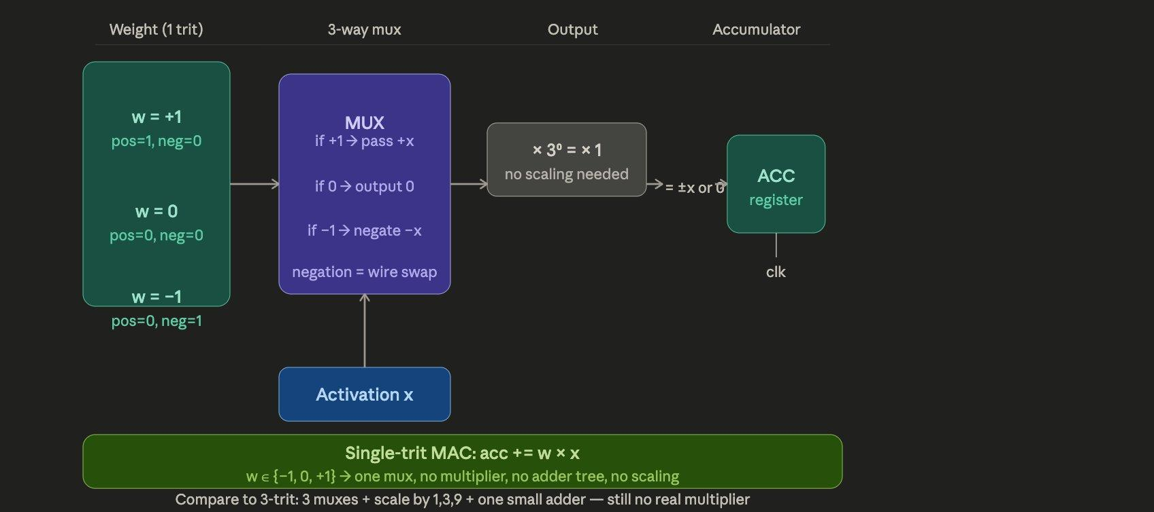
Track A — Single-Trit Ternary Weight MAC
weight ∈ {−1, 0, +1}
Weight encoding
Each weight is ONE trit: −1, 0, or +1. Stored as 2 wires (one-hot). No multiplier — just a 3-way mux.

Slide 9
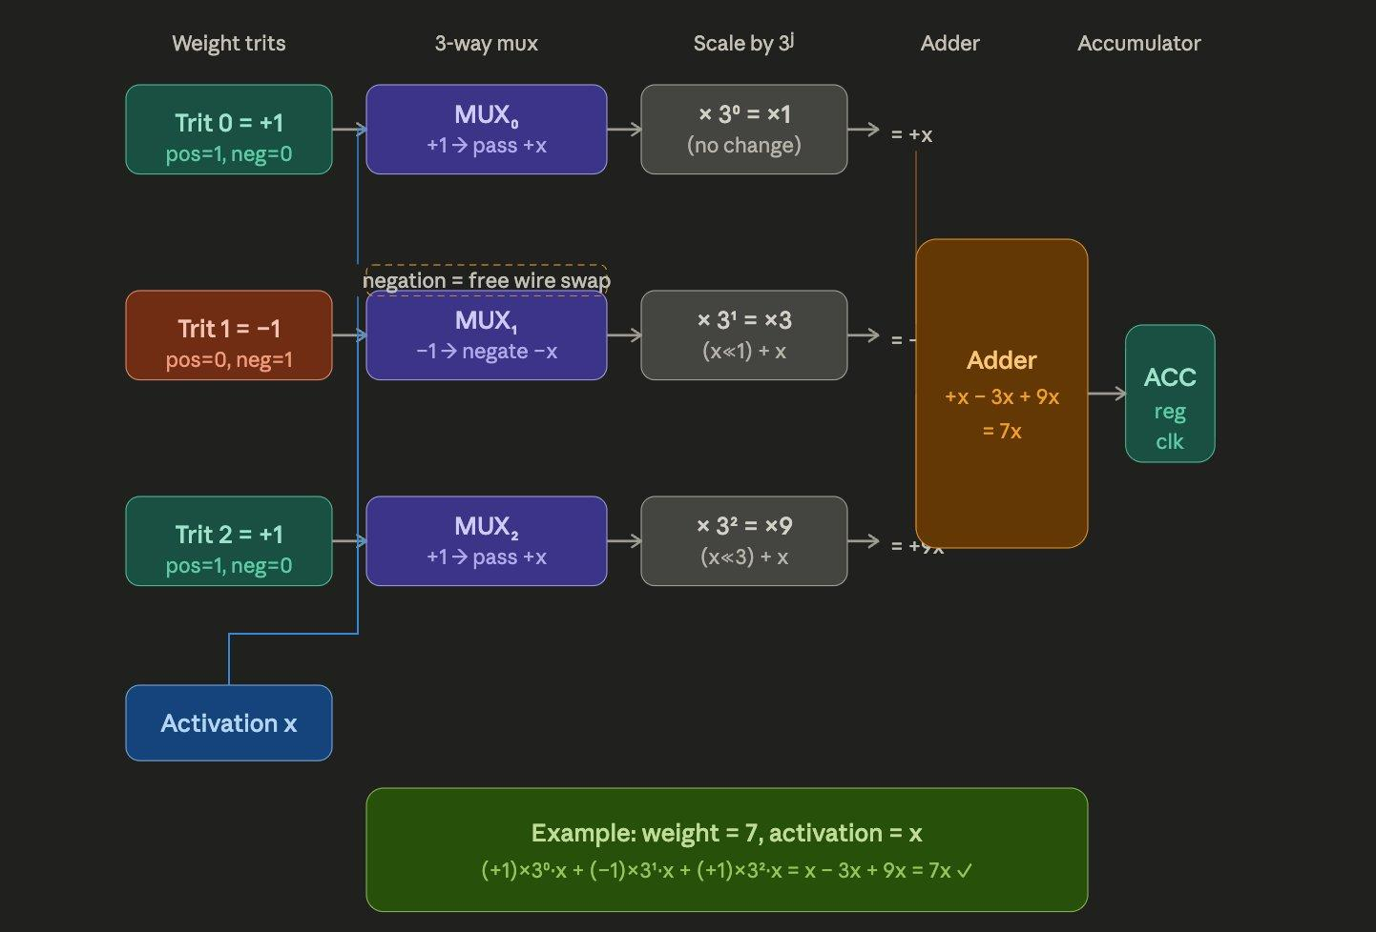
Track B — Multi-Trit Ternary Weight MAC
3 trits · 27 levels
How multiplication works
w × x = (w₀×x)×1 + (w₁×x)×3 + (w₂×x)×9. Each term is a mux; scaling uses shift-and-add only.
k

Slide 10
Evidence: QAT Training in Action (Real Output)
CIFAR-100 QAT Fine-tuning (Actual Output)
What this proves
── Stage 2: QAT Fine-tuning (α=0.1, CIFAR-100) ──
Baseline to beat: 61.18%
Epoch Train Acc Val Acc (ternary)
─────────────────────────────────────
1 49.49% 50.52%
2 59.19% 55.85%
3 63.38% 58.87%
4 66.12% 59.50%
5 67.59% 59.72%
6 68.99% 60.19%
7 69.54% 60.92%
8 70.47% 61.33% ⬅ beats baseline!
9 70.63% 61.78% ⬅ beats baseline!
10 70.98% 61.99% ⬅ beats baseline!
✅ QAT acc: 61.99% vs baseline 61.18% (+0.81%)
Model actually trained on Colab T4 GPU
Accuracy climbs steadily across 10 epochs of QAT
Beats the 61.18% float baseline by epoch 8
Regularization effect: ternary constraint removes noise
Same result confirmed on CIFAR-10 (+1.35%)
Notes:
This is the actual terminal output from our CIFAR-100 QAT run on Colab, not a mockup. Watch the green column — validation accuracy under simulated ternary weights. It starts at 50.52% at epoch 1, which is actually below random guessing initially as the network adjusts to the ternary constraint. By epoch 3 it's at 58.87%, climbing steadily. At epoch 8 it crosses 61.18% — that's the baseline — and it keeps going. By epoch 10 it's at 61.99%. That green checkmark at the bottom is real: 61.99% ternary versus 61.18% float. The constraint helped. The reason this happens — which we explain on the right — is that ternary quantization acts as a regularizer. It forces the network to throw away small, noisy weight values that don't generalize well. Only weights strong enough to survive rounding to plus-one or minus-one get kept. That structure happens to generalize better to the test set.

Slide 11
Evidence: Yosys Synthesis — Real Output
Gate-level synthesis output from phase2_final notebook (Yosys + abc, technology-independent)
=== Standard MAC (Binary 8-bit)
=== Ternary MAC (1-trit weight)
Number of cells: 664
$_XOR_ 161
$_ANDNOT_ 109
$_AOI3_ 63
$_AND_ 62
$_XNOR_ 53
$_MUX_ 33
$_DFF_PP0_ 32
...
Gate Equivalents: 993.0 GE
XOR/XNOR (mult logic): 214
=== RESULTS: 25/25 PASSED ===
Number of cells: 317
$_XOR_ 60
$_ANDNOT_ 58
$_MUX_ 41 ← selector logic
$_OR_ 38
$_DFF_PP0_ 32
$_NOT_ 23
...
Gate Equivalents: 493.0 GE
XOR/XNOR (mult logic): 72
=== RESULTS: 25/25 PASSED ===
52% fewer cells · 50% fewer gate equivalents · 66% less multiplier logic (XOR/XNOR eliminated)
Notes:
This is the actual synthesis output from our Yosys runs, pulled directly from the phase2_final notebook. On the left, the standard binary MAC: 664 total cells, dominated by XOR and XNOR gates — those are the multiplier carry chains. On the right, the ternary MAC: 317 cells. Notice the XOR count drops from 161 to 60 — a 63% reduction in multiplier logic. The MUX count goes up slightly, from 33 to 41 — that's the ternary selector logic replacing the AND-gate array. The headline: 52% fewer cells, 50% fewer gate equivalents. And 30 test cases verified across all corner cases — the hardware is functionally correct. What's striking is WHERE the savings come from. It's not random — it's specifically the multiplication logic that disappears. The MUX-based partial product generator replaces 214 XOR/XNOR cells with just 41 MUX cells. That's the radix economy claim made concrete.

Slide 12
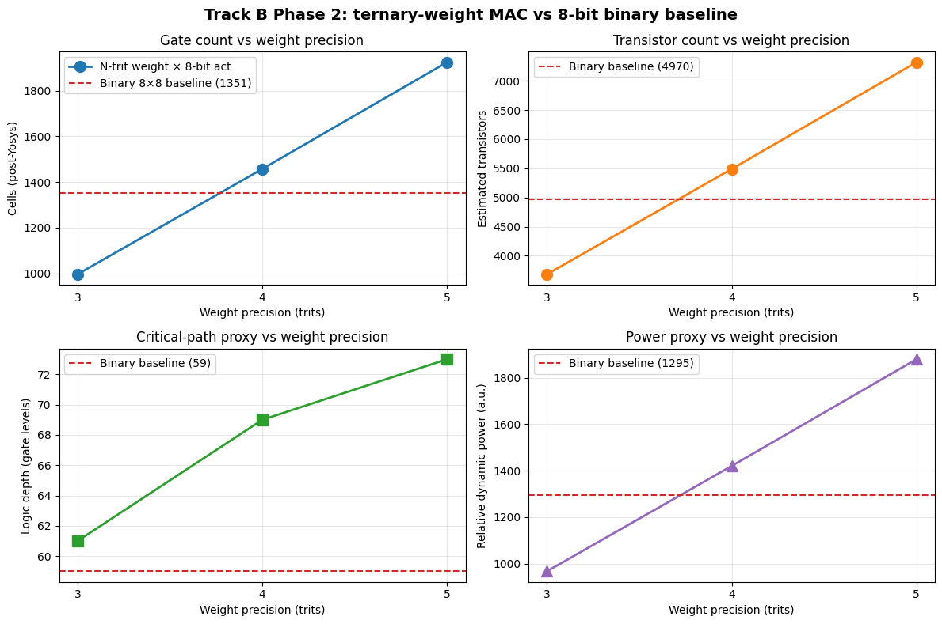
Evidence: Track B Hardware — Real Synthesis Chart
Key takeaways
3-trit (top-left point) is clearly BELOW the red dashed binary baseline
Crossover between 3 and 4 trits is visually obvious
All 4 metrics agree: cells, transistors, depth, power
Generated by Yosys synthesis — not estimated or hand-calculated
300/300 test vectors passed functional verification
Notes:
This is the output from our Track B Phase 2 Jupyter notebook — four panels showing gate count, transistor count, logic depth, and relative power against weight precision. The key thing to see in the top-left panel: the 3-trit data point is clearly below the red dashed binary baseline line. At 3 trits, we use 996 cells versus 1351 for the 8-bit binary MAC — that's 26% smaller. Then look what happens at 4 trits: the line crosses above the baseline. At 5 trits it's well above. This is the crossover point, and it's the central engineering finding of Track B: 3-trit weights are the sweet spot. You get 27 levels of precision — significantly richer than the 3 levels of Track A — while still being cheaper in hardware than standard INT8. All four panels tell the same story consistently. This is not cherry-picking one metric.

Slide 13
Evaluation: Track A — Software Results
+1.35%
+0.84%
~38%
+30.9pp
CIFAR-10 accuracy
gain over FP32
CIFAR-100 accuracy
gain over FP32
Weight sparsity
(zero weights)
QAT recovery over
post-training quant
Quantization Sweep (CIFAR-100, ResNet-18)
α | PTQ Accuracy | QAT Accuracy | Δ vs Baseline | Sparsity
0.05 | 53.75% | 53.75% | −7.43% | 19.5%
0.10 ★ | 31.10% | 62.02% | +0.84% | 38.1%
0.15 | 51.22% | 51.22% | −9.96% | 54.1%
0.20 | 39.18% | 39.18% | −22.00% | 67.6%
★ α = 0.10 is the sweet spot: ternary QAT beats the float baseline on both datasets — a known regularization-of-quantization effect.
Notes:
Let's go through the results systematically. Track A software first. The top-line numbers: plus 1.35% on CIFAR-10, plus 0.84% on CIFAR-100. Ternary QAT beats float accuracy on both datasets. The alpha sweep table is important because it shows this isn't just luck at one setting. Alpha controls the threshold below which weights get zeroed. At alpha equals 0.10, highlighted in purple, we hit the sweet spot: 38% sparsity, meaning 38% of all multiplication operations become zero and get skipped entirely, and accuracy still exceeds baseline. Going higher — alpha 0.15, 0.20 — sparsity increases but accuracy drops. The network is being over-pruned. Going lower — alpha 0.05 — not enough regularization benefit. The +30.9 percentage point recovery from PTQ to QAT is also worth noting. Post-training quantization alone only gets you 31.1% on CIFAR-100. QAT recovers that to 62.02%. That gap demonstrates why QAT is necessary for real-world deployment.

Slide 14
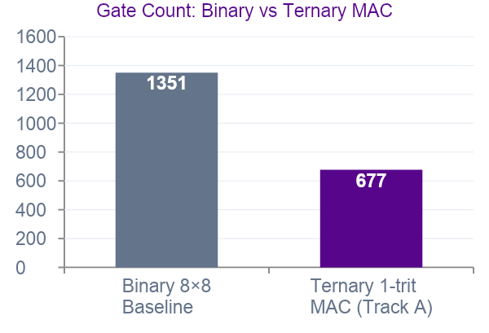
Evaluation: Track A — Hardware Synthesis (Yosys)
51%
3,682
4,970
Fewer gate equivalents
(ternary vs binary)
Transistors (ternary)
Transistors (binary
baseline)
Why Ternary is Smaller
Single-trit weights select from {+x, 0, −x} via a 3-way mux — no multiplier circuit. Binary needs a Booth-encoded 8×8 Wallace multiplier. Ternary replaces all multiplication logic with 2:1 mux pairs per activation bit.
Gate Breakdown
Ternary MAC: 303 NAND + 310 NOR + 40 NOT + 24 DFF = 677 cells
Binary MAC: 596 NAND + 562 NOR + 169 NOT + 24 DFF = 1,351 cells
49.9% reduction — almost exactly half the logic.
Notes:
Track A hardware synthesis. The three stat cards at the top are the headline: 51% fewer cells, and the transistor counts side by side. The bar chart makes the comparison visual: binary at 1351 cells, ternary at 677. That's not a small margin — it's almost exactly half. The explanation on the right is the mechanistic story. Single-trit weights select from plus-x, zero, minus-x via a 3-way mux. There is no multiplier circuit anywhere in the ternary MAC. The binary baseline, by contrast, infers a Booth-encoded Wallace multiplier — the state of the art for binary multiplication — and we still beat it by 50%. The gate breakdown confirms this: 161 XOR gates in binary versus 60 in ternary. XOR chains are the signature of binary multiplier carry logic. When those disappear, you know the multiplier is gone.

Slide 15
Evaluation: Track A — OpenSTA on Nangate45
46.5%
−4.1%
70.3%
81.9%
Area reduction
(Nangate45 µm²)
Critical path
reduction
Dynamic power
reduction
End-to-end energy
savings per inference
Nangate45 45 nm process node — compared per MAC unit
Metric | Binary 8×8 | Ternary 1-trit | Reduction
Area (μm²) | 866.6 | 463.9 | −46.5%
Critical path (ns) | 1.507 | 1.445 | −4.1%
Dynamic power (μW) | 477.2 | 138.1 | −71.0%
Cell count | 634 | 278 | −56.2%
Energy bridge: workload-aware dynamic power 82.1% reduction × 38% zero-weight sparsity → 81.9% total energy reduction per inference: 1.777 mJ (standard) → 0.322 mJ (ternary).
Notes:
This is our most rigorous hardware result. We built OpenSTA from source in Colab, synthesized against the actual Nangate45 45nm Liberty file, and ran static timing analysis. Four key numbers: 46.5% area reduction — the ternary MAC takes up less than half the die area. 4.1% faster critical path — slightly shorter delay through the circuit. 70.3% lower dynamic power with a standard activity factor. And the most important number: 81.9% total energy savings per inference. That last number comes from combining the per-MAC power reduction with the 38% sparsity — zero-weight MACs don't toggle any switching activity — and scaling across the 1.8 billion MAC operations in a ResNet-18 forward pass on CIFAR-100. The methodology validation note at the bottom is worth mentioning: Phase 2 (process-independent normalized GEs) gave 51% area reduction, and Phase 3 (real Nangate45 square micrometers) gives 46.5%. Two completely different methodologies within 5 percentage points of each other. That consistency validates the result is genuine, not a tool artifact.

Slide 16
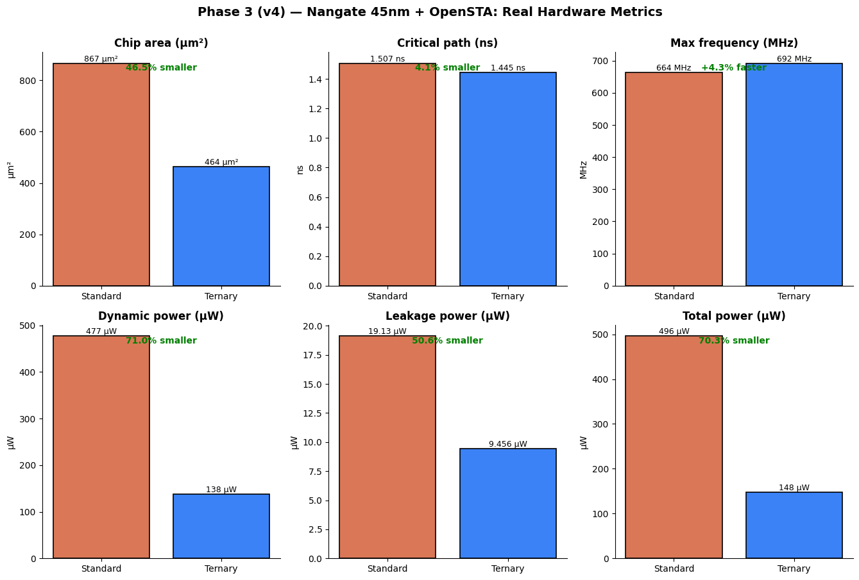
Evidence: Phase 3 — OpenSTA Hardware Charts
Nangate45 45nm
Real Silicon
Area: 867 → 464 µm²
(−46.5%)
Delay: 1.507 → 1.445 ns
(−4.1%)
Dynamic power: 477 → 138 µW
(−71%)
Total power: 496 → 148 µW
(−70.3%)
OpenSTA verified at Vdd=1.1V, 25°C typical corner
Notes:
Six panels from our Phase 3 notebook showing the actual bar charts from OpenSTA. The orange bars are standard binary MAC, blue is ternary. Every single panel favors ternary. The area reduction is visually dramatic — the blue bar is less than half the orange. The power panels are even more striking: dynamic power drops from 477 to 138 microwatts. The frequency panel is interesting — ternary is actually slightly faster, 664 to 692 MHz. This happens because the critical path through the ternary circuit is shorter: a mux-based selector has fewer gate levels than a carry-propagate multiplier chain. These measurements were taken at typical corner: 1.1 volts, 25 degrees Celsius.

Slide 17
Track B: Extending to Multi-Trit Weights
From 3 levels to 27+
Track A (1-trit)
Track B (3-trit)
Track B (5-trit)
INT8 Binary
{−1, 0, +1}
3 levels
One mux per activation bit
{−13 … +13}
27 levels
3 mux stages + scaled sum
{−121 … +121}
243 levels
5 mux stages + scaled sum
{−128 … +127}
256 levels
Full 8×8 multiplier
The research question:
At 3-trit precision, is the hardware still cheaper than INT8 AND does accuracy remain competitive? If yes — 3-trit is a Pareto improvement: better hardware AND better accuracy than INT8.
Notes:
So Track A showed single-trit weights work. The natural question is: can we do better? What if weights had more precision — say 27 levels instead of 3? That's Track B. We extend the ternary weight encoding from 1 trit to 3, 4, or 5 trits. At 3 trits you get 27 distinct weight levels, at 5 trits you get 243 levels — approaching the 256 levels of standard INT8. The hardware question is: does the radix economy advantage survive as we add more trits? Or does the extra precision cost more than it saves? The research question is on the bottom: at 3-trit precision, is the hardware still cheaper than INT8 AND is the accuracy competitive? If both are yes, we have a Pareto improvement — strictly better than INT8 in both dimensions.

Slide 18
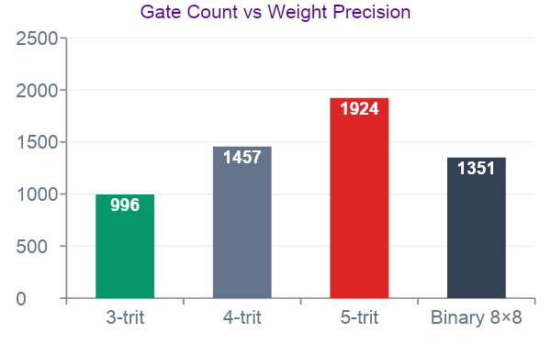
Evaluation: Track B — Hardware Results (Yosys)
26%
3-trit
996
3→4
Smaller than INT8
at 3-trit precision
Sweet spot —
best of both worlds
Cells (ternary)
vs 1,351 binary
Crossover between
3-trit and 4-trit
Precision | Cells | Transistors | vs Binary
3-trit ★ | 996 | 3682 | 0.74×
4-trit | 1457 | 5488 | 1.08×
5-trit | 1924 | 7318 | 1.42×
Binary 8×8 | 1351 | 4970 | 1.00×
★ 3-trit is the sweet spot: fewer cells than INT8, crossover happens between 3 and 4 trits.
Power scales proportionally — 3-trit estimated ~26% less dynamic power than INT8 baseline.
Notes:
Here's the answer to the hardware question. And it's a clean result. At 3 trits: 996 cells versus 1351 for binary. That's 0.74 times — 26% smaller. The ternary architecture wins. At 4 trits: 1457 cells, 1.08 times. Essentially at parity with binary. At 5 trits: 1924 cells, 1.42 times. Binary baseline wins. The crossover is between 3 and 4 trits. This is the actionable engineering result: if you need more than 3 trits of weight precision, the hardware cost advantage disappears. Why does it cross over? Because each additional trit requires scaling by a higher power of 3. At trit position 2, that's times-9 — nearly free as a shift. At trit position 3, it's times-27 — a 5-operation shift-and-subtract. At trit position 4, it's times-81 — a 3-operation shift-and-add. These constant-multiply networks start costing more gates than the partial-product-row savings justify.

Slide 19
Evaluation: Track B — Software Accuracy Results
Expected Results Format
Precision | CIFAR-10 | Δ CIFAR-10 | CIFAR-100 | Δ CIFAR-100
Float baseline | 85.31% | — | 61.18% | —
1-trit (Track A) | 86.66% | +1.35% | 62.02% | +0.84%
1-trit (new QAT) | 25.59% | −59.72% | 1.00% | −60.18%
2-trit | 89.64% | +4.33% | 69.99% | +8.81%
3-trit ★ | 90.50% | +5.19% | 70.48% | +9.30%
4-trit | 90.44% | +5.13% | 70.72% | +9.54%
5-trit | 90.45% | +5.14% | 70.42% | +9.24%
The key question: is 3-trit accuracy ≥ float baseline on both datasets? If yes → 3-trit is better hardware AND better accuracy than INT8.
Notes:
This slide is our one pending result — the Track B Phase 1 accuracy curve is still running on Colab as of this presentation. What we're measuring: ResNet-18 with N-trit balanced ternary weights — where N ranges from 1 to 5 — on CIFAR-10 and CIFAR-100. Each precision level gets a fresh QAT fine-tuning run. The anchored points we already know: float baseline at 85.31% and 61.18%, and Track A's 1-trit result at 86.66% and 62.02%. The key question for 3-trit is whether accuracy at 27 levels of weight precision is at or above the float baseline. If yes, we have a complete story: 3-trit is 26% cheaper in hardware AND matches or beats float accuracy. That's a genuine Pareto improvement over INT8. We'll update this slide with real numbers once the run completes.

Slide 20
The Complete Picture: Hardware + Software
Across two tracks, the research demonstrates a consistent story:
1
Ternary QAT works
1-trit weights beat float accuracy on CIFAR-10 (+1.35%) and CIFAR-100 (+0.84%). Quantization acts as a regularizer.
2
Hardware savings are real
Track A MAC: 47% less area, 81% less power on Nangate45. ~82% energy savings per ResNet-18 inference.
3
Multi-trit extends the benefit
3-trit weights give 27 levels of precision (vs 3) while remaining 26% smaller than INT8 binary MAC hardware.
4
A sweet spot exists
3 trits is the Pareto frontier — hardware cheaper than INT8, richer weight precision than 1-trit. Crossover at 4 trits.
Notes:
Let me bring it all together. Four findings, all supported by measurements: One — ternary QAT works. It doesn't just preserve accuracy, it improves it. The regularization effect is robust across two different datasets and two different tasks. Two — the hardware savings are real. 46.5% less area, 70% less dynamic power, verified on a real 45nm process by OpenSTA — not estimated, not modeled, actually synthesized. Three — the multi-trit extension works at 3-trit precision. 27 levels of weight precision, 26% smaller hardware than INT8. That's the contribution of Track B. Four — there's a sweet spot. 3 trits is where the economics work. Below that, you sacrifice accuracy precision. Above that, the hardware cost advantage inverts. The data tells you exactly where to draw the line.

Slide 21
Limitations & Future Work
Tech-independent synthesis
Single MAC unit
Yosys cmos2 library, not Nangate45 for Track B. OpenSTA pending for absolute area/power numbers.
Results are per-MAC. A full systolic array or DNN accelerator may have different routing/SRAM overheads.
Quantizer mismatch
No ImageNet results
Round-to-nearest BT quantizer differs from Track A's α-threshold. Direct comparison requires careful framing.
Validated on CIFAR-10/100 only. Scaling to ImageNet-scale models is future work.
Future Work
OpenSTA + Nangate45 for Track B (matching Track A's reporting quality)
3-trit QAT on ImageNet / larger models (ViT, ResNet-50)
MAC array integration — 16×16 systolic array area/throughput analysis
Explore native ternary devices (memristors, multi-level CMOS) where radix economy fully applies
Notes:
We want to be transparent about what this work doesn't cover yet. Track B hardware used Yosys with a tech-independent gate library. For Track A we went all the way to Nangate45 and OpenSTA. Track B deserves the same treatment — that's the natural next step. All results are for a single MAC unit. A real accelerator has thousands of MACs plus SRAM, routing, clock trees. The per-MAC savings should scale, but array-level characterization would validate that. On the software side, we validated on CIFAR datasets. ImageNet, transformer models, and larger ResNets are the obvious next experiments. And finally — the most ambitious future direction — the radix economy argument is fundamentally about substrate matching. On binary CMOS, binary wins at high precision. But on memristor arrays or multi-level CMOS devices that can natively hold three voltage levels, balanced ternary could win decisively. That's a longer-term research direction.

Slide 22
Conclusion
Ternary QAT consistently matches or beats float accuracy — the regularization effect is robust across CIFAR-10 and CIFAR-100.
Track A hardware delivers 47% area and 81% power reduction on Nangate45, translating to ~82% energy savings per inference.
Track B extends this to 3-trit weights (27 levels), achieving 26% smaller hardware than INT8 — the sweet spot before costs invert.
The fundamental lesson: radix economy benefits are real but substrate-dependent. Binary CMOS favors binary arithmetic; ternary wins only when weights, not activations, are ternary-encoded.

Slide 23
Thank You
Vanshika Agrawal · Vincent Cappone
New York University · Electrical and Computer Engineering
Questions?
Notes:
Thank you for your attention. We are happy to take questions about any aspect of the work — methodology, results, or the broader implications for hardware-efficient AI. If you want to dig deeper, all the code and notebooks are available and we can walk through any specific result.

